Slide 1
Lab 2: Containerization
Docker

Slide 2


The "It Works On My Machine" Dilemma
“Finally the feature works, time to push it into production”
Production crashes
* DOOM SIREN *
“I have tested the feature and it works on my machine”
“We're not giving the customer your machine”

Slide 3
The "It Works On My Machine" Dilemma
Problem
An application runs perfectly on your machine but fails on other machines
Cause
Different kernels, versions of libraries, missing packages, conflicting configurations
Solution
Package the (application + dependencies) into a self-contained virtual machine / container
Result
Your application becomes a portable installation that runs consistently across any environment that supports the application container/virtual machine.

Slide 4
Virtualization vs. Containerization
Virtualization
Creates virtual machines emulating entire hardware systems (CPU, RAM, storage, network).
Each VM runs a full guest OS
Examples: VMware, VirtualBox

Slide 5
Virtualization Architecture
VM
VM
VM
VM
VM
VM
Hypervisor
A software layer that manages and isolates virtual machines
Types
Type 1 (Bare-metal)
Example: VMWare
Type 2 (Hosted)
Example: VBox, VMWare
App
App
App
App
App
App
Guest OS
Guest OS
Guest OS
Guest OS
Guest OS
Guest OS
Hypervisor
Hypervisor
Operating System
Hardware
Hardware
Type 1
Type 2

Slide 6
Virtualization Drawbacks
VM
VM
VM
Resource Consumption
Each application requires its own virtual machine with its own OS, pre-allocated disk volume, RAM and CPU
Slow Boot Times
VMs take a lot of time to boot as they load up the entire OS, this can be problematic for rapid on-demand scaling
Complex Management
Keeping multiple OS’s up-to date
VM images take up a lot of storage, hindering portability
App
App
App
Guest OS
Guest OS
Guest OS
Hypervisor
Operating System
Hardware
Virtualization

Slide 7
Containerization
Container
Container
Container
Container Engine
Creates wrapper processes (containers) shipped with the correct dependencies which run natively on the host OS kernel, using Linux namespaces.
Enforces necessary resource isolation and limitation, using cgroups
Key Advantages
Resource Efficiency
Improved portability
App
App
App
libs/bin
libs/bin
libs/bin
Container Engine
Operating System
Hardware

Slide 8
Containerization: Runtime
Container
Container
Container
Control groups (Cgroups)
A cgroup allocates and limits resources that are used by a collection of processes
Namespaces
It is a linux feature that allows processes to have isolated views of the system resources
Example namespaces: PID, Mount, UTS (hostnames), IPC, NET, User, Cgroup, Time
App
App
App
libs/bin
libs/bin
libs/bin
Namespaces
Cgroups
SELINUX
SECCOMP
Hardware

Slide 9
The Foundation of Container Runtimes
Engine: Main interaction point for end user
Containerd: core container runtime that manages container lifecycle on a single host, it pulls/pushes images and owns the resources (storage, networking, etc.)
Engine
Containerd
OCI Spec
runc
Container
Interacts with kernel to create container processes
Isolated process running within the host, packaged with its dependencies

Slide 10
Summary
Characteristic | Virtualization | Containerization
Isolation Tech | Hypervisor | Cgroups + namespaces
Performance | Moderate (HV overhead) | High
Image Size | Big | Small
# Operating Systems | = # of images | 1
Modularity | Low | High (Kubernetes)

Slide 11
VM
VM
VM
App
App
App
Guest OS
Guest OS
Guest OS
Hypervisor
Operating System
Hardware

Slide 12
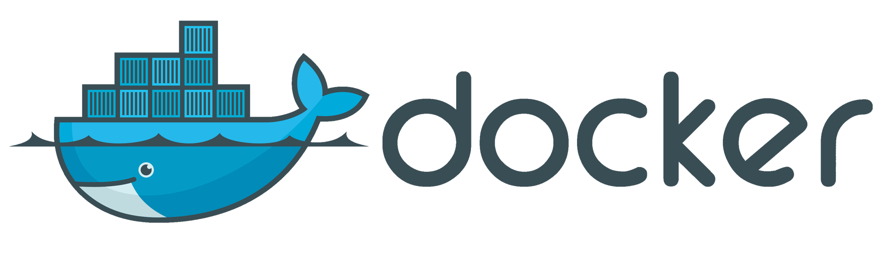

Slide 13
Docker
Engine
Containerd
OCI Spec
runc
Container
Interacts with kernel to create container processes
Isolated process running within the host, packaged with its dependencies

Slide 14
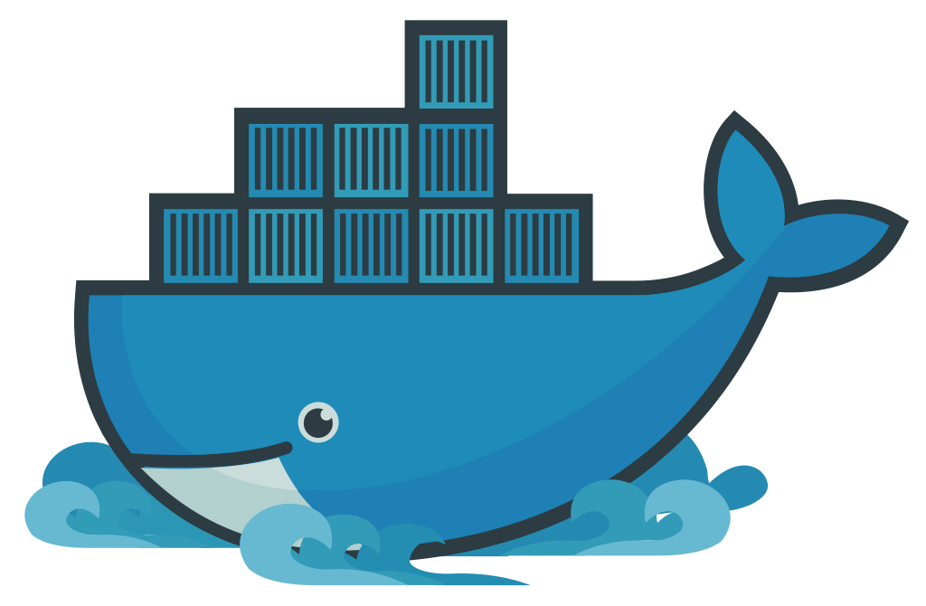
Docker
Docker is a platform that simplifies the process of building, shipping and running apps using containers
It leverages containerd and runc to run containers
Docker is written in Go
Containerd
OCI Spec
runc
Container
Interacts with kernel to create container processes
Isolated process running within the host, packaged with its dependencies

Slide 15
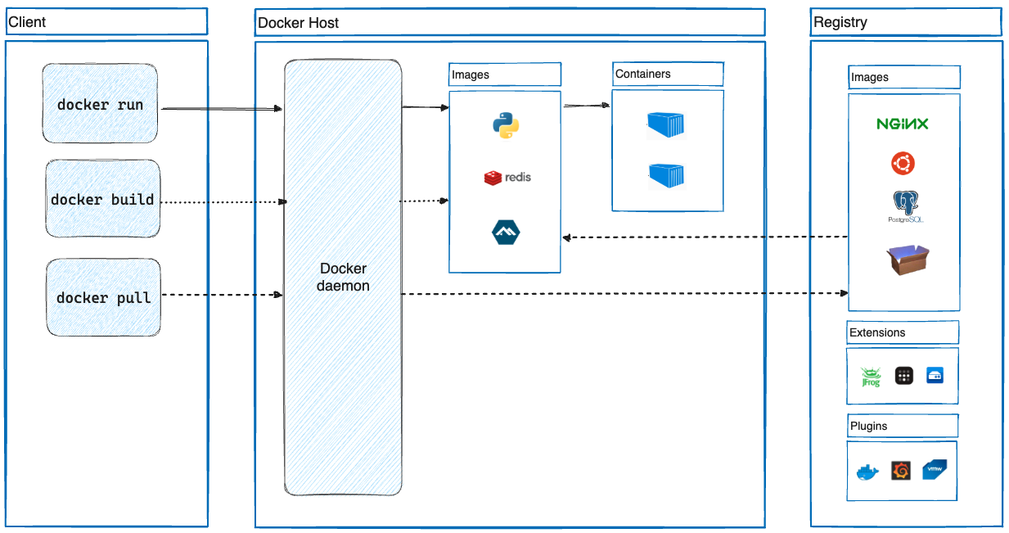
Docker Architecture
Client: It allows the user to issue API commands to the docker daemon
Docker Host
dockerd: Listens for Docker API requests and processes them
Docker objects: Images, Containers, Storage, Networks
Docker Registry: An online repository containing docker images

Slide 16
Docker Daemon: The Orchestrator
dockerd is the core background service it provides
API: Listens for Docker client commands, on UNIX sockets
Images: Pulls, builds, stores and caches the images
Containers: Manages container lifecycle via containerd and runc
Networking/Storage: Manages networks and volumes occupied by docker
How it works
Client sends a request to dockerd on the docker socket
dockerd parses the request, and applies the transformation to the relevant docker objects (images, containers, storage, network)

Slide 17
Docker Images: The blueprints
They are the foundation for creating containers. They are read-only templates with instructions for dockerd for creating a docker container
Images are built in layers, each layer represents a change to the filesystem, this allows efficient image sharing and caching
Where to find images?
From an image registry e.g., Docker hub (public) or your private repository
How are images used?
When you run docker run command, docker uses the specified image to create a container (process)
The image is loaded into the container’s filesystem and the commands specified are executed

Slide 18
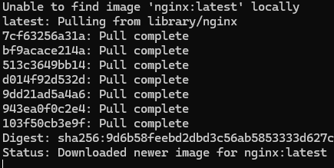
Docker Images: Downloading
Running docker run -d -p 8080:80 nginx for the first time
dockerd doesn’t find this image in the local repo
dockerd fetches image from the default remote repository (Docker Hub)
dockerd starts downloading (pulling) the image in a layered manner
dockerd caches the layers for later use

Slide 19
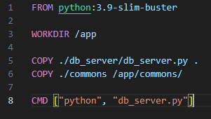
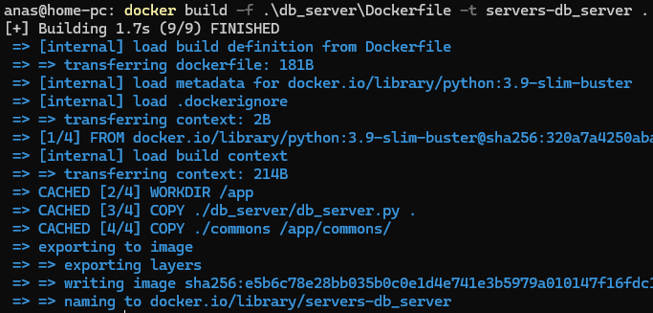
Docker Images: Building your own
You can also build your own docker images using a Dockerfile
A Dockerfile contains declarative instructions on how to construct an image

Slide 20
Docker Images: Dockerfile Instructions
FROM → Specifies the base image to use.
RUN → Executes commands in the container during the image build process.
COPY → Copies files or directories from the host machine into the image.
ADD → Similar to COPY, but with additional functionalities.
CMD → Provides the default command to run when a container is started.
ENTRYPOINT → Configures a container to run as an executable.
WORKDIR → Sets the working directory for any subsequent RUN, CMD, ENTRYPOINT, COPY, and ADD instructions.
ENV → Sets environment variables within the image.
Notes:
FROM → Specifies the base image to use. Every Dockerfile must start with a FROM instruction.
RUN → Executes commands in the container during the image build process. Each RUN instruction adds a new layer to the image.
COPY → Copies files or directories from the host machine into the image.
ADD → Similar to COPY, but with additional functionalities like extracting TAR files and fetching files from URLs.
CMD → Provides the default command to run when a container is started from the image.Only one CMD instruction is allowed; if multiple are specified, only the last one takes effect.
ENTRYPOINT → Configures a container to run as an executable. It allows you to set a default application that will run every time a container is instantiated from the image.
WORKDIR → Sets the working directory for any subsequent RUN, CMD, ENTRYPOINT, COPY, and ADD instructions.

Slide 21
Docker Networking: Overview
Docker networking enables communication between containers, the host system, and external networks.
Default Network Modes:
Bridge: Containers on same host talk via IPs. Ports must be mapped for external access.
Host: Containers use host's network directly. Fast, but port conflicts are possible.
Overlay: Multi-host communication; used in Swarm.
Macvlan: Containers appear as physical devices.
None: Total network isolation.
Port Mapping
Allows external systems reach services inside containers using host ports
Example
-p 8080:80 → Maps port 80 in the container to port 8080 on the host.

Slide 22
Docker Networking: Communication
Networking Mode | Communication Inside the Container |  | Communication from Outside the Container
 | To Other Containers on Same Network | To External Services
Bridge | Use container names or IP addresses. | Containers can access external networks directly. | Requires port mapping to access container services via the host's IP and specified port.
Host | Communicate over the host's network using standard networking methods. | Direct access as if running on the host. | Services are accessible via the host's IP and the service's native port without additional port mapping.
Overlay | Use container names or IP addresses. | Access depends on network configuration. | Typically requires port mapping and appropriate routing to access services.
Macvlan | Use assigned MAC or IP addresses. | Direct access based on network setup. | Accessible using the container's unique MAC and IP address, similar to a physical device on the network.
Notes:
Bridge Network: Containers can communicate with each other using their names or IPs. External access requires explicit port mapping.
Host Network: Containers share the host's network stack, making services accessible via the host's IP without additional port mapping.
Overlay Network: Facilitates communication between containers across multiple hosts. External access depends on specific configurations.
Macvlan Network: Assigns a unique MAC address to each container, allowing them to appear as physical devices on the network.
None Network: Provides complete network isolation; the container has no network interface.

Slide 23
Docker Persistence
Ephemeral Nature of Containers: By default, Docker containers are stateless; any data written inside a container is lost upon its removal or restart. This poses challenges for applications requiring persistent data storage, such as databases or services managing user-generated content.

Slide 24
Docker Persistence
Volumes
Provides a way to persist data by creating storage outside the container
Data remains intact across container restarts and removals
Volumes can be shared among multiple containers
Creating a Volume: docker volume create my_volume
Running a Container with a Volume: docker run -d -v my_volume:/path/in/container
Mounts
Mount a host file or directory onto the container at a specified path
Suitable for scenarios requiring direct access on the host file system, such as configuration files or source code during development.

Slide 25
Docker Mounts vs. Volumes
 | Mount | Volume
Management | Managed by host | By docker
Portability | Tied to host directory structure | Can be easily backed up and migrated
Security | Exposes host’s directories | Isolated

Slide 26
Docker Compose - Introduction
Docker Compose is a tool (client) that allows developers to define and manage multi-container Docker applications using a single YAML file.
Key Features:
Service Definition: Specify each service (e.g., databases, web servers) in the application, including configurations and dependencies
Networking: Automatically handles networking between services, ensuring seamless communication
Volumes: Manage persistent data storage across container restarts

Slide 27
Docker Compose - Benefits and Use Cases
Benefits:
Control multi-container applications with straightforward commands
Maintain uniform environments across development, testing, and production stages
Reduce setup time and streamline workflows by defining configurations in a single file
Use Cases:
Easily replicate complex environments for local development
Set up isolated environments for running test suites
Deploy applications on a single server with minimal configuration

Slide 28
Demo

Slide 29
References
Docker Get Started
Containers vs. VMs

